Slide 1
WishfulBazaar Sales Perfromance & Customer Analysis
Heryanto Jaya (link to Linkedin)

Slide 2
1
Introduction

Slide 3
Executive Summary
1
4
2
5
3
6
Purpose & Context
Product & Payment Trends
Dashboard created to support leadership decision-making for FY2023 review.
Top products: TV, Laptop, Microwave; 2023 shift to Cash on Delivery
Sales Performance
Geographical Performance
Sales success rate at 74.45%; abandonment at 15.69%, returns at 9.86%
Canada leads in sales; Japan underperforms significantly
Customer Behaviour
Strategic & Opportunities
All customers are one-time buyers; no repeat
purchases observed
Profit dropped –33.75% from 2022–2023; action needed on loyalty, UI issues.

Slide 4
Methodology
1
4
2
5
3
6
Data Sources
Key Metrics Analysed:
Sales data from 2019–2023 (FY2024 under audit)
Sales Success Rate, Returned & Abandoned Sales
Session Duration per Customer
Company Profit
Tools Used
Tableau for dashboard and visualization
Analytical Techniques
Binning analysis
Scatter plots
LOD and table calculations
Data Integration
Joining Data with details
on this slide
Geographical Insights
Regional success variance analyzed

Slide 5
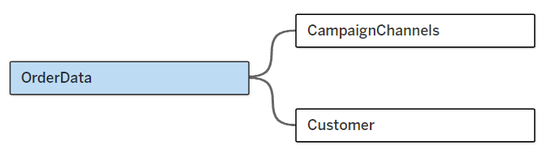
Data Joining
Joining OrderData with CampaignChannels on SessionID (after changing format from numeric to string) for analyzing relationship of Campaign Schema with Generated Sales
And joining OrderData with Customer on CustomerID (after changing format from numeric to string) to create binning analysis on Customer data and Sales

Slide 6
2
Scorecard
Link to tableau file or public for full calculation

Slide 7
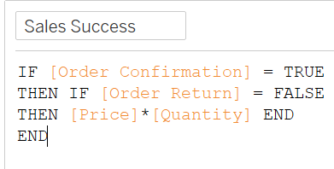
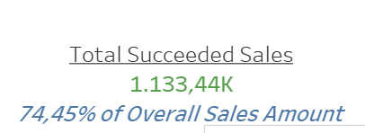
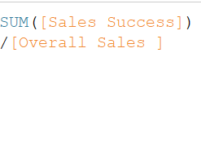
Sales Success Rate is 74.45%
Formula
Result

Slide 8
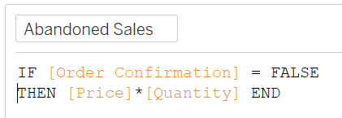
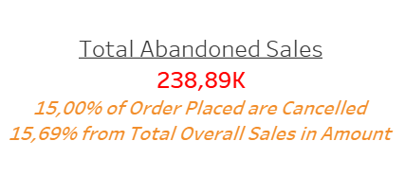


Sales Abandonment Rate is 15.69%
Formula
Result

Slide 9
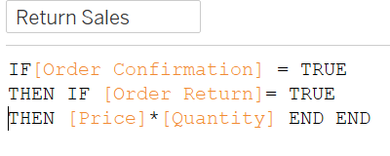
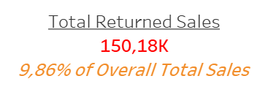

Returned Sales Rate is 9.86%
Formula
Result

Slide 10
3
Chart Ploting
Link to tableau file or public for full version

Slide 11
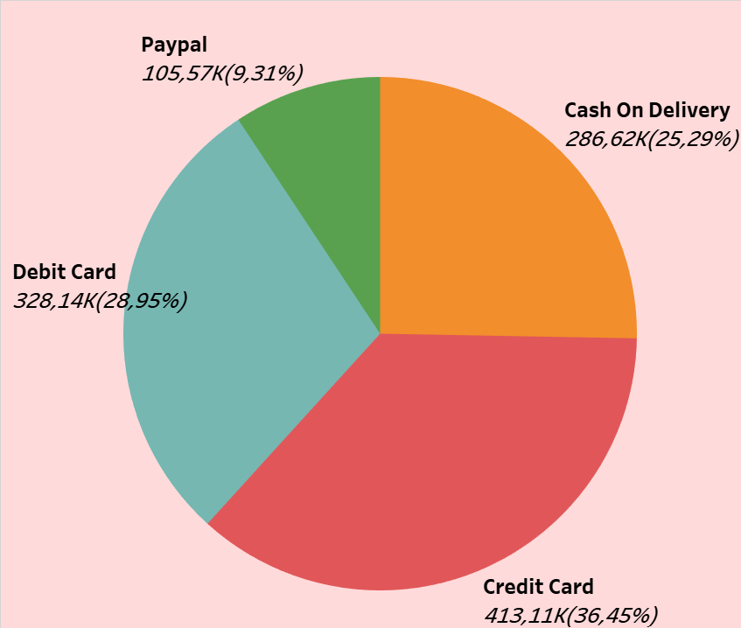
Credit Card is the most preferred payment method during 2019-2023 in Succeded Sales

Slide 12
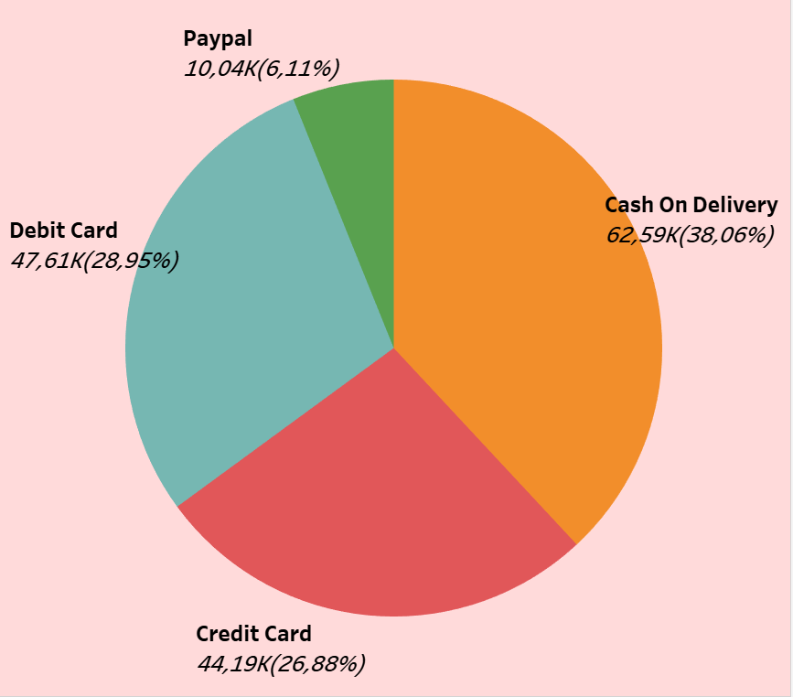
Interestingly in 2023, most of Succeeded Sales is under Cash on Delivery Payment Method

Slide 13
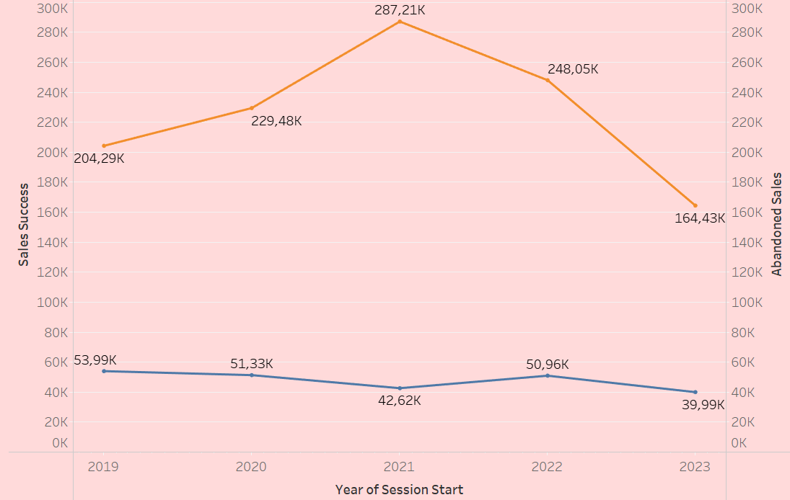

Most Succeeded Sales Nominal is in 2021, while most abandoned sales is in 2019

Slide 14
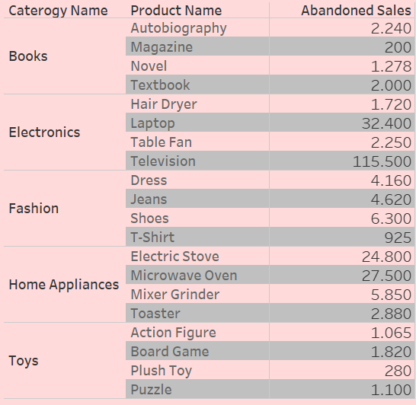
Television under Electronic Category has the most Abandoned Sales during 2019-2023

Slide 15
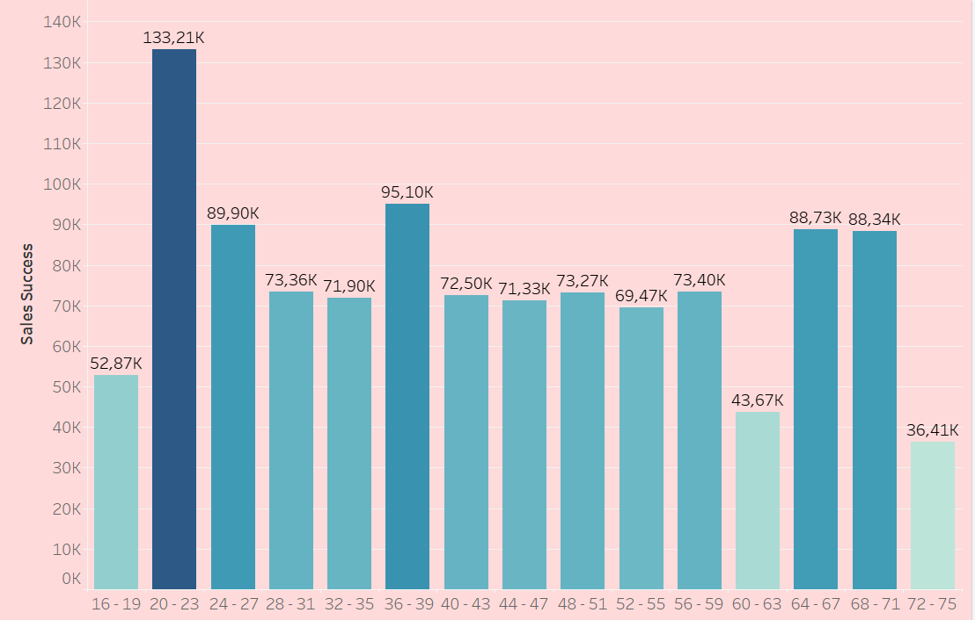
Most Successful Sales is within Cust Age 20-23 during 2019-2023

Slide 16
4
LOD & Table Calculation
Link to tableau file or public for full version

Slide 17
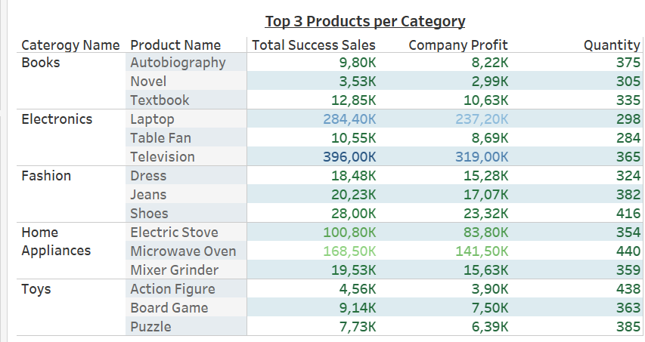
Top 3 Products per Category
Electronics and Home Appliances are top performers in sales and profit, led by Television, Laptop, and Microwave Oven. Fashion maintains strong margins, while Books and Toys have lower overall performance. High quantity sold doesn’t always mean high profit, as seen with Action Figures.

Slide 18
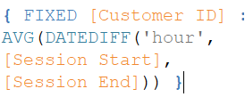

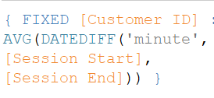
Customer Duration
Per Hour Formula
Result
Per Minute Formula

Slide 19
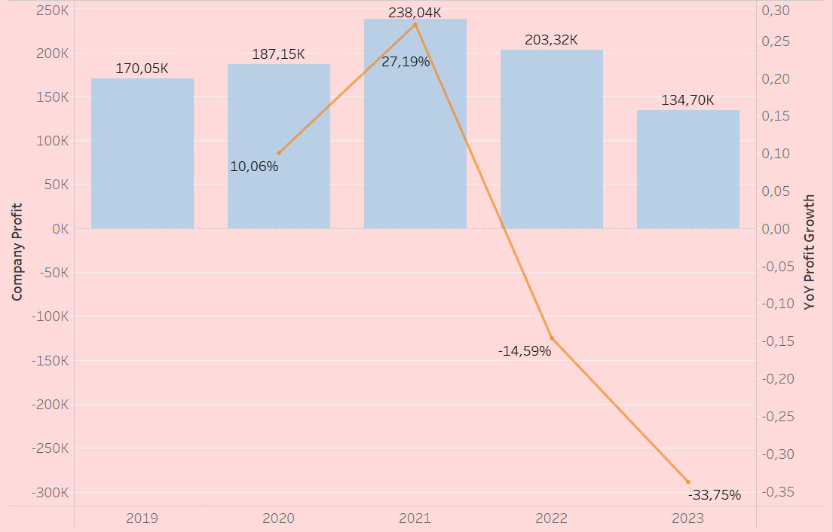
Company Profit Peaked in 2021, but has declined sharply since

Slide 20
5
PO & Income

Slide 21
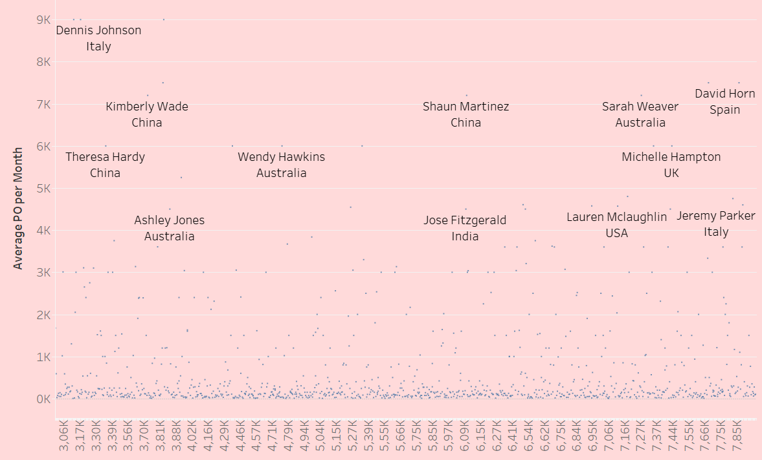
Scattered Correlation between monthly income & monthly average purchase order

Slide 22
Scatter Plot Interpretation
The dots are widely scattered without forming a clear upward or downward trend
High-income customers does not consistently have high average PO Values
The correlation coefficient between Average monthly Purchase Order and Monthly Income is 0.01052 (tableau sheet 17)
Hence, There is likely weak or no linear correlation between Monthly Income and Average PO per Month in this dataset

Slide 23
6
Geographical

Slide 24
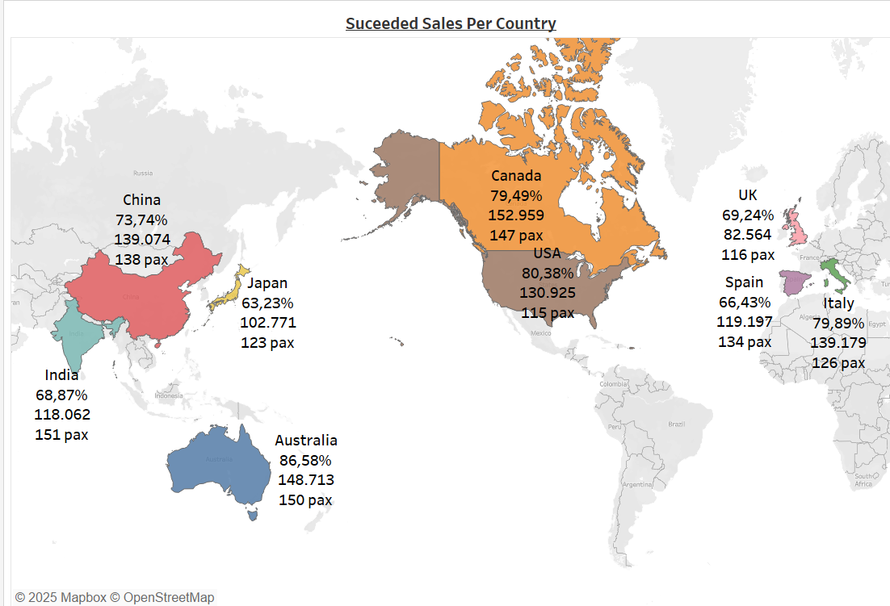

Slide 25
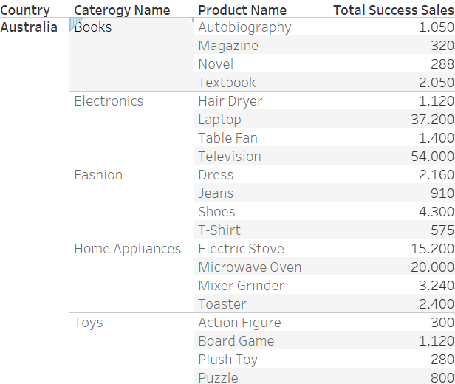
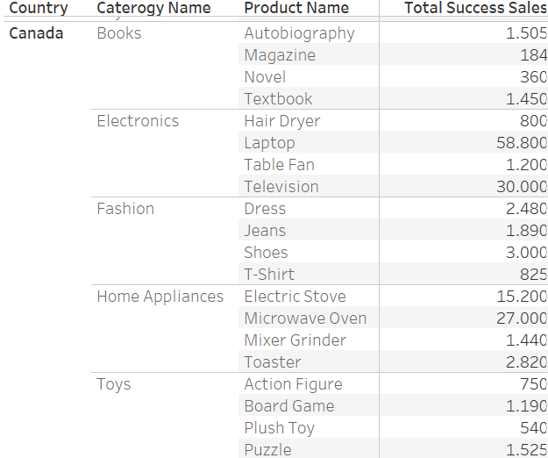
Geographical Interpretation
Canada generates most of Succeeded Sales during 2019 – 2023
However, Australia has the most percentage of Succeeded Sales
Japan has least succeeded sales, while least successful sales percentage is in Spain
Details in Australia and Canada are as below

Slide 26
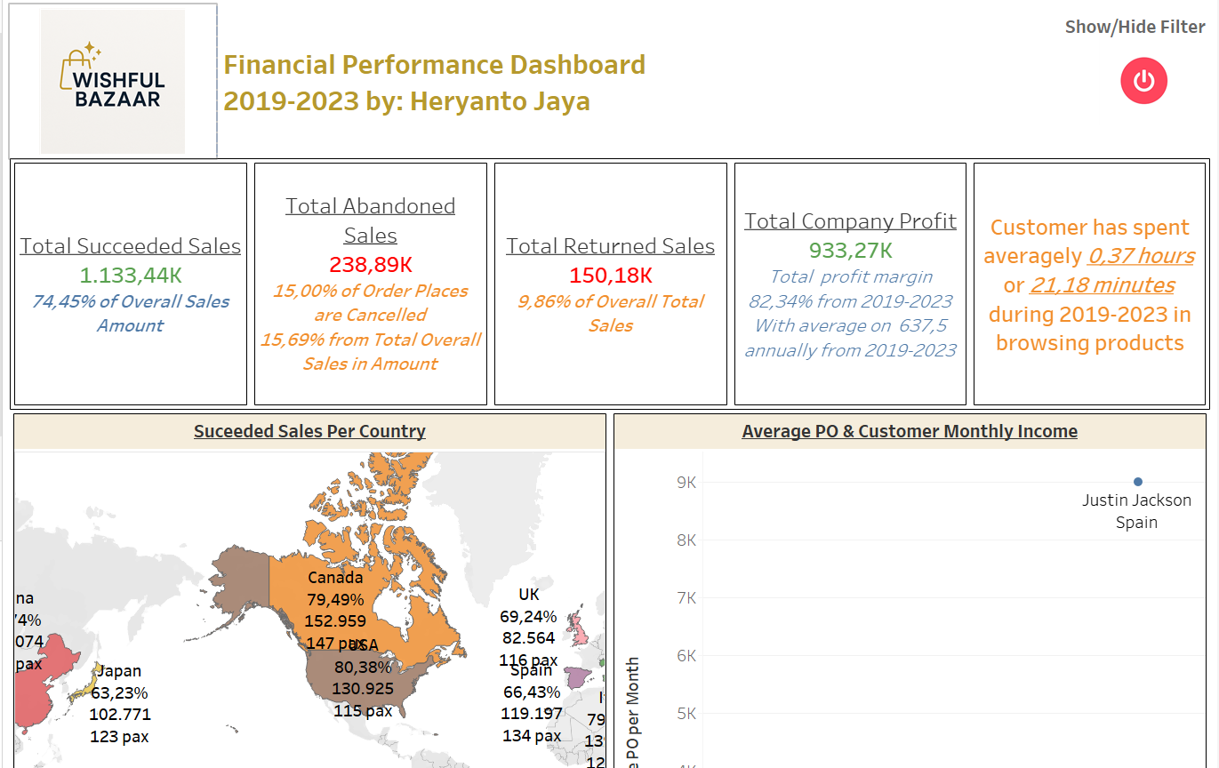
Dashboard
Full version on Tableau

Slide 27
Insights Summary
Customers’ monthly Income does not materially affect the WishfullBazaar Performance
Most of customers are from India, while least customer from USA, however it gives better sales performance during 2019-2023 than India
All customer have only 1 transaction during 2019-2023, as no duplicated data in customer id per session id, means no repeat order from existing customer or all customer are just walk in customer
From 2019 to 2021, profit growth is uphill but have downhill from 2022 to 2023, where hit the bottom in 2023 with growth – 33.75%
Television is the best profit generator, followed by Laptop and Microwave Oven, while the least is Novel

Slide 28
Business Recommendation
To retain the customer, provide loyalty scheme for subsequent order or giving point per transaction
Abandoned sales may come from user interface issue and application problem, for example like bug in payment gateway or application. Recommended for discussion with UI and App Developer team
Need to review the going concern on selling Novel with Business Development Team as it gives least profitability
Advisable to conduct review to find the cause of least successful sales in Japan
However, the one which need most of the attention is declining profit growth from 2022 to 2023, need to find the root cause as soon as possible due to going concern indication. (Our competitor, WishfulThingking Mart has the operation ceased after 2-year declining profit consecutively)

Slide 29

Thank You

